Slide 1
MSDS 6306: Doing Data Science - Case Study 01
October 22, 2019
Sid Swarupananda & Sean Mcwhirter

Slide 2
Introduction & Overview
In this Case Study, we used Beers dataset which contains a list of 2410 US craft beers and Breweries dataset which contains 558 US breweries to address the questions listed below
How many breweries are present in each state?
Address the missing values in each column.
Compute the median alcohol content and international bitterness unit for each state. Plot a bar chart to compare.
Which state has the maximum alcoholic (ABV) beer? Which state has the most bitter (IBU) beer?
Comment on the summary statistics and distribution of the ABV variable.
Is there an apparent relationship between the bitterness of the beer and its alcoholic content? Draw a scatter plot. Make your best judgment of a relationship and EXPLAIN your answer.
Budweiser would also like to investigate the difference with respect to IBU and ABV between IPAs (India Pale Ales) and other types of Ale (any beer with “Ale” in its name other than IPA). You decide to use KNN clustering to investigate this relationship. Provide statistical evidence one way or the other. You can of course assume your audience is comfortable with percentages … KNN is very easy to understand.
Knock their socks off! Find one other useful inference from the data that you feel Budweiser may be able to find value in. You must convince them why it is important and back up your conviction with appropriate statistical evidence.

Slide 3
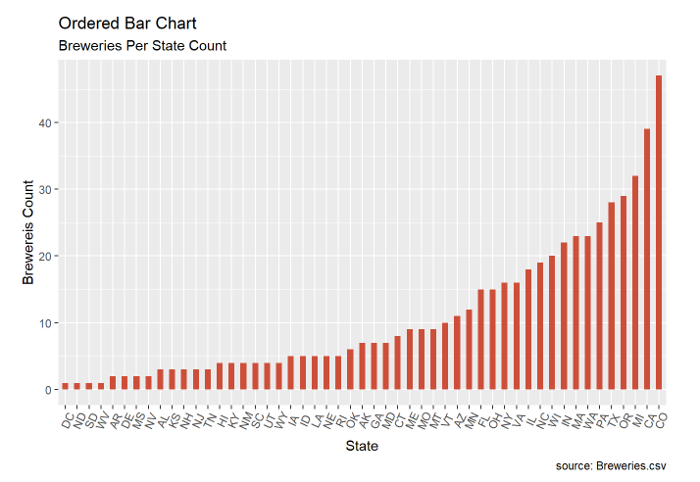
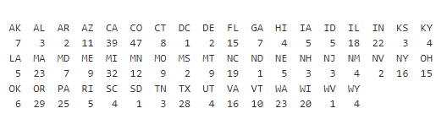
MSDS 6306: Case Study 01
How many breweries are present in each state?

Slide 4
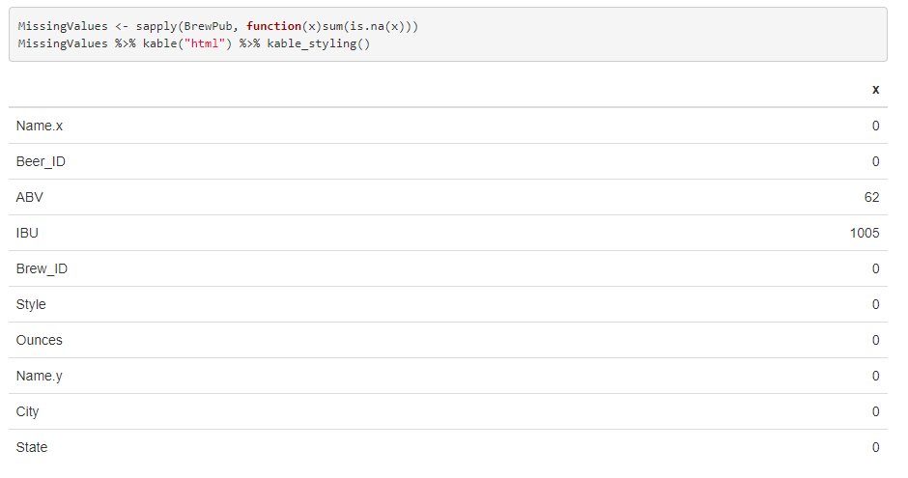
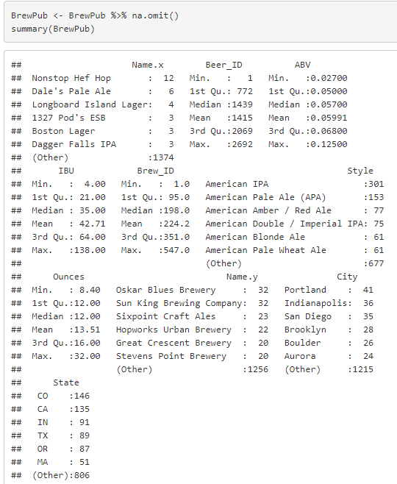
MSDS 6306: Case Study 01
Address the missing values in each column.

Slide 5
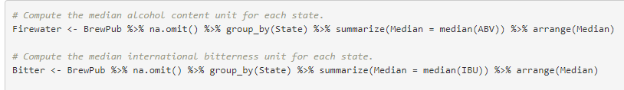
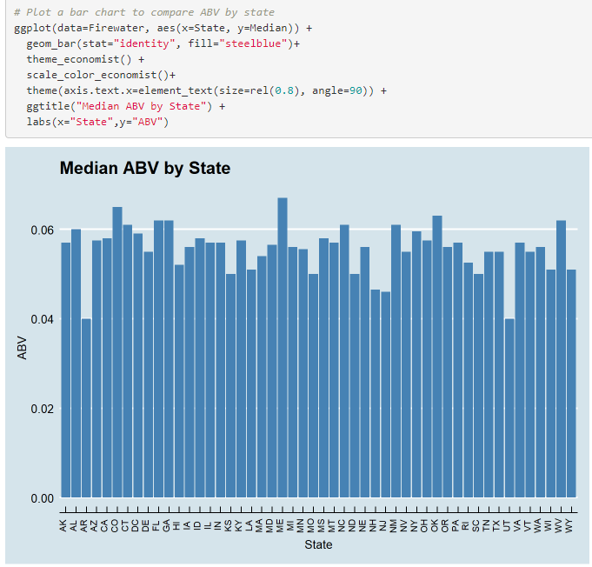
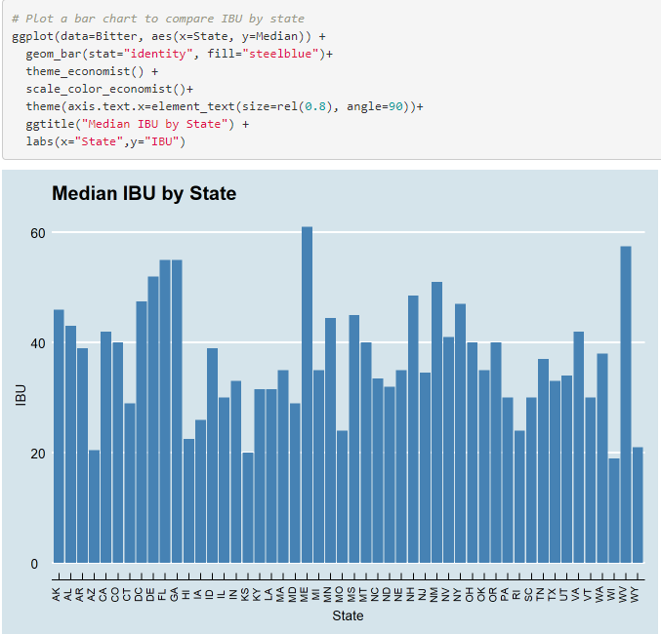
MSDS 6306: Case Study 01
Compute the median alcohol content and international bitterness unit for each state. Plot a bar chart to compare.

Slide 6
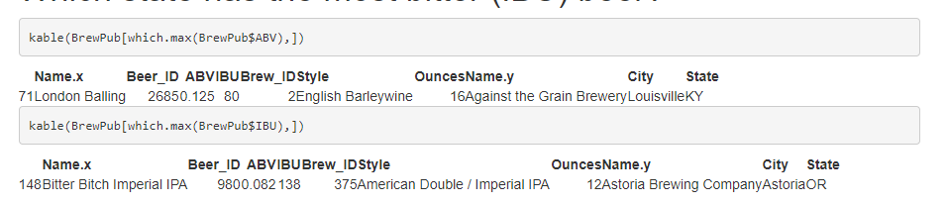
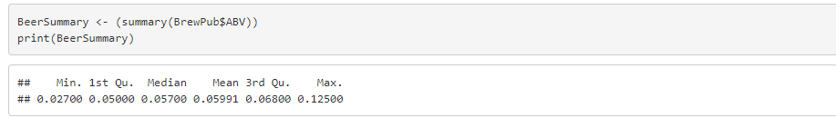
MSDS 6306: Case Study 01
Which state has the maximum alcoholic (ABV) beer? Which state has the most bitter (IBU) beer?
Comment on the summary statistics and distribution of the ABV variable.

Slide 7
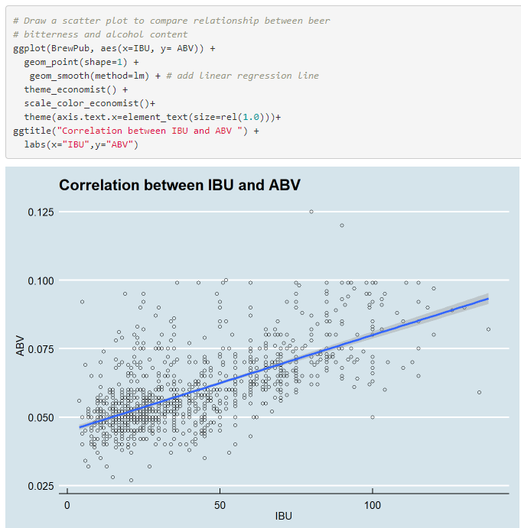
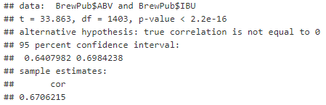
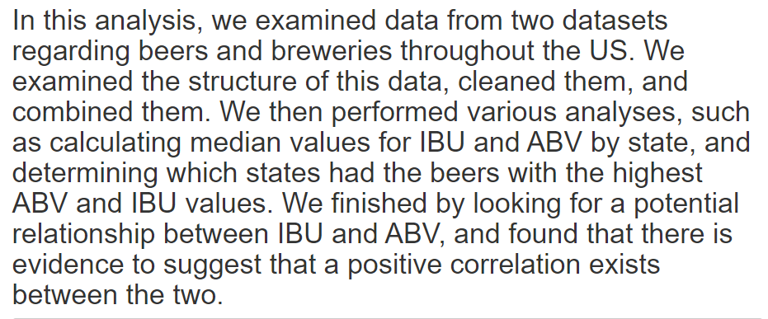
MSDS 6306: Case Study 01
Is there an apparent relationship between the bitterness of the beer and its alcoholic content? Draw a scatter plot. Make your best judgment of a relationship and EXPLAIN your answer.

Slide 8
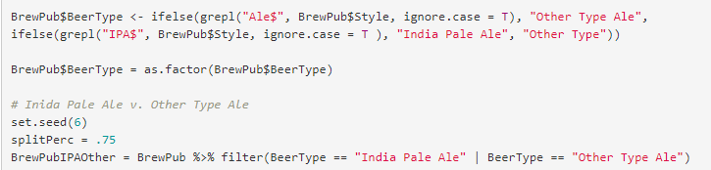
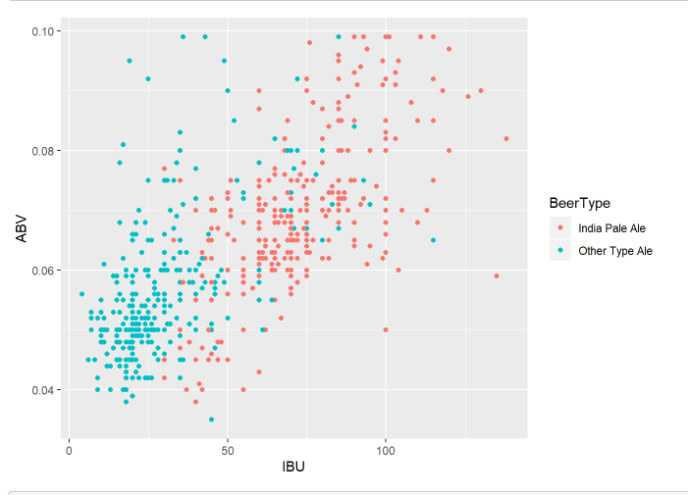
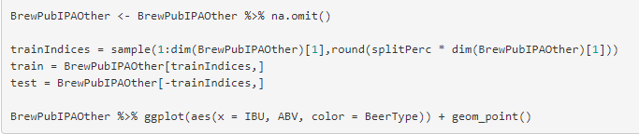
MSDS 6306: Case Study 01
Budweiser would also like to investigate the difference with respect to IBU and ABV between IPAs (India Pale Ales) and other types of Ale (any beer with “Ale” in its name other than IPA).

Slide 9
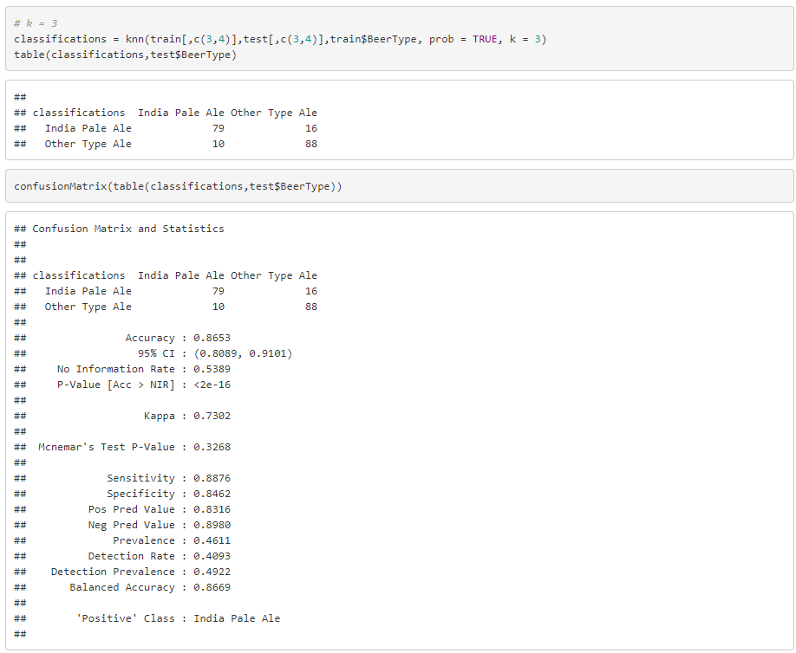
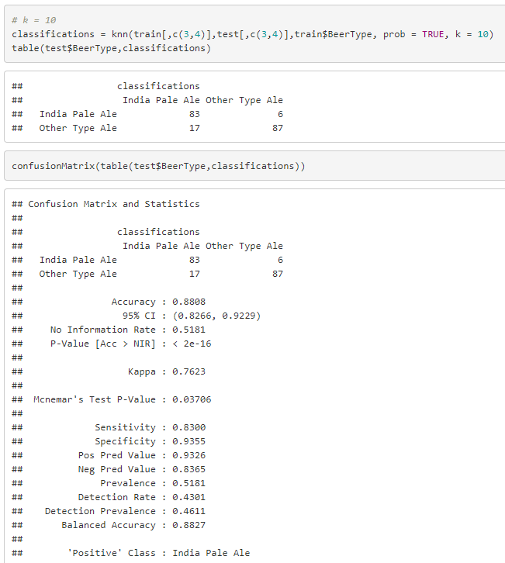
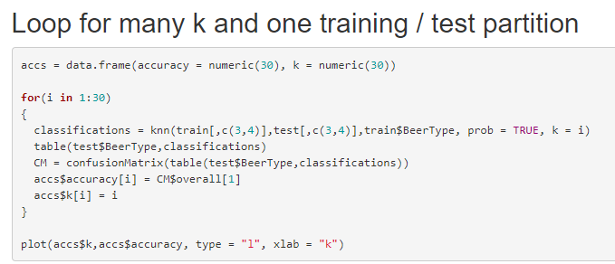
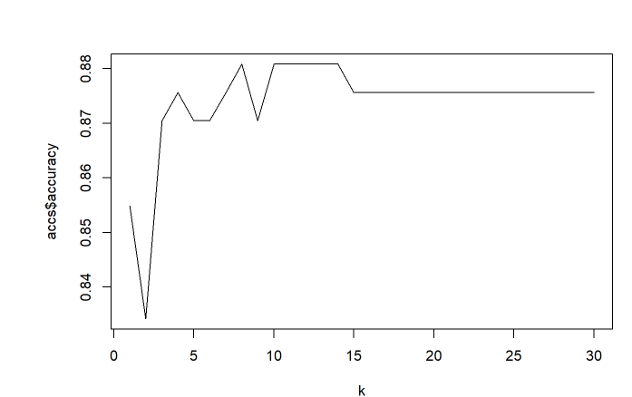
MSDS 6306: Case Study 01
Knn method to investigate the difference with respect to IBU and ABV between IPAs and Other Type of Ale

Slide 10
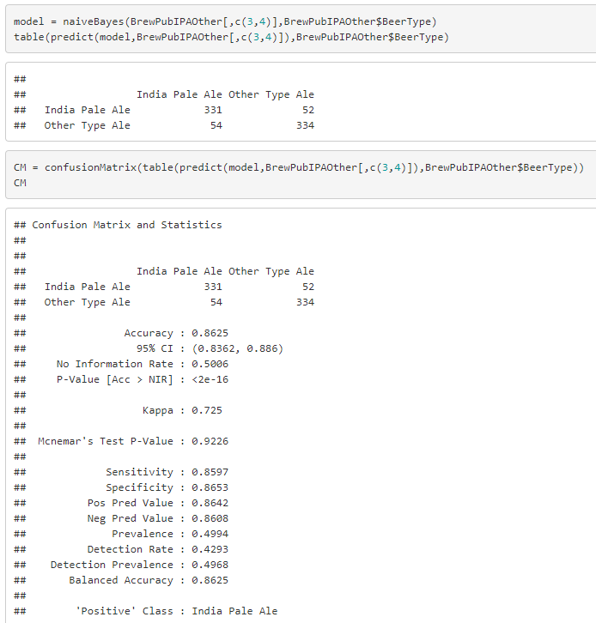
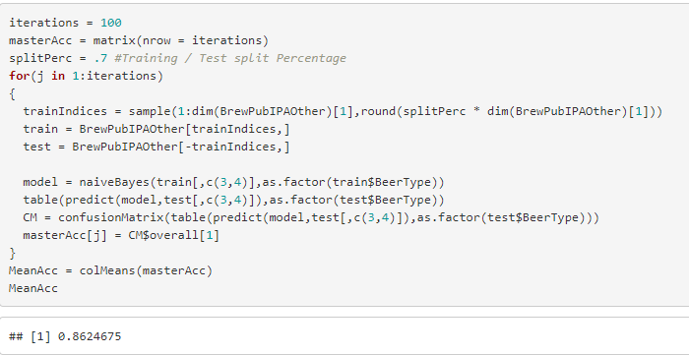
MSDS 6306: Case Study 01
Naïve Bayes method to investigate the difference with respect to IBU and ABV between IPAs and Other Type of Ale

Slide 11
Key Takeaways

